Slide 1

Probabilistic Model Checking
Marta Kwiatkowska
Gethin Norman
Dave Parker
University of Oxford
Part 3 - DTMC Case Studies

Slide 2

Overview
Introduce two real-world examples
  derived models as discrete-time Markov chains
  quantitatively analysed them (with PRISM)
  observed unusual trends…
Bluetooth device discovery
  worked from the standard document (1000 pages), versions 1.1 and 1.2
Contract signing
  worked from the original paper, discovered a flaw and proposed a fix
See PRISM webpage for models and more analysis…

Slide 3

Bluetooth device discovery
Bluetooth: short-range low-power wireless protocol
  widely available in phones, PDAs, laptops, ...
  personal area networks (PANs)
  open standard, specification freely available
Uses frequency hopping scheme
  to avoid interference (uses unregulated 2.4GHz band)
  pseudo-random selection over 32 of 79 frequencies
Network formation
  piconets (1 master, up to 7 slaves)
  self-configuring: devices discover themselves

Slide 4
Bluetooth device discovery
States of a Bluetooth device:
  standby: default operational state
  inquiry: device discovery
    master looks for devices, slaves listens for master
  page: establish connection - synchronise clocks, etc.
  connected: device ready to communicate in a piconet
Device discovery
  mandatory first step before any communication possible
  “page” reuses information from “inquiry” so is much faster
  power consumption much higher for “page”
  performance crucial

Slide 5
Frequency hopping
freq₁
freq₂
freq₁
freq₂
freq₃
freq₄
freq₃
freq₄
send
send
scan
scan
send
send
scan
scan
28 bit free-running clock CLK, ticks every 312.5μs
Master broadcasts inquiry packets on two consecutive frequencies, then listens on the same two (plus margin)
Potential slaves want to be discovered, scan for messages
Frequency sequence determined by formula, dependent on bits of clock CLK (k defined on next slide):
freq = [CLK₁₆₋₁₂+k+ (CLK_{4-2,0}-CLK₁₆₋₁₂) mod 16] mod 32

Slide 6
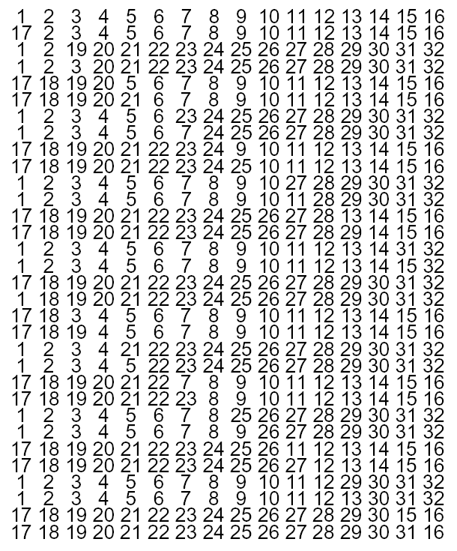
Master (sender) behaviour
Broadcasts inquiry packets on two consecutive sequences, then listens on the same two
Frequency hopping sequence determined by clock
freq = [CLK₁₆₋₁₂+k+ (CLK_{4-2,0}-CLK₁₆₋₁₂) mod 16] mod 32
  two trains (=lines) of 16 frequencies (determined by offset k)
  each train repeated 128 times
  swaps between trains every 2.56s

Slide 7
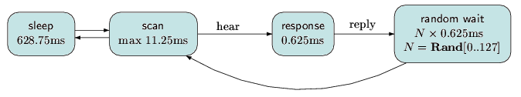
Slave (receiver) behaviour
Listens (scans) on frequencies for inquiry packets
  must listen on right frequency at right time
  cycles through frequency sequence at much slower speed (every 1.28s)
On hearing packet, pause, send reply and then wait for a random delay before listening for subsequent packets
  avoid repeated collisions with other slaves

Slide 8
Bluetooth modelling
Very complex interaction
  genuine randomness, probabilistic modelling essential
  devices make contact only if listen on the right frequency at the right time!
  sleep/scan periods unbreakable, much longer than listening
  cannot omit sub-activities, otherwise model is oversimplified
Huge model, even for one sender and one receiver!
  initial configurations dependent on 28 bit clock
  cannot fix start state of receiver, clock value could be arbitrary
But is a realistic future ubiquitous computing scenario!

Slide 9
Bluetooth – PRISM model
Modelling in PRISM [DKNP06]
  model one sender and one receiver
  synchronous (clock speed defined by Bluetooth spec)
  randomised behaviour – use DTMC
  model at lowest-level (one clock-tick = one transition)
  use real values for delays, etc, from Bluetooth spec
Modelling challenges
  complex interaction between sender/receiver
  combination of short/long time-scales – cannot scale down
  sender/receiver not initially synchronised, huge number of possible initial configurations (17,179,869,184)

Slide 10
Bluetooth - Results
Huge DTMC!
  initially, model checking infeasible
  partition into 32 scenarios, i.e. 32 separate DTMCs
  on average, approx. 3.4 x 10⁹ states, 536,870,912 initial
  can be built/analysed with PRISM's MTBDD engine
Property model checked:
  R_{=?} [ F replies=K {“init”}{max} ]
  “worst-case (maximum) expected time to hear K replies, over all possible initial configurations”
  also: how many initial states for each possible expected time
  and: cumulative distribution function assuming equal probability for each initial state

Slide 11
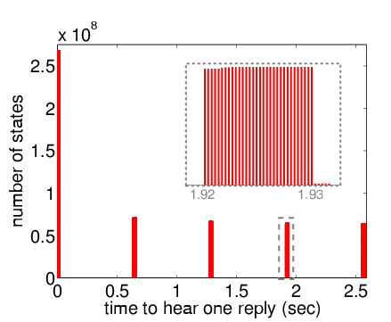
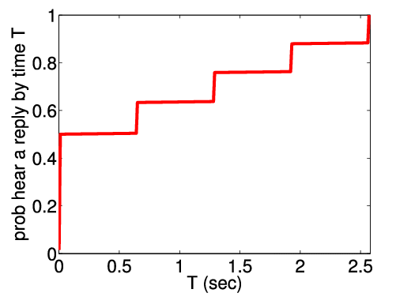
Bluetooth - Time to hear 1 reply
Worst-case expected time = 2.5716s
  in 921,600 possible initial states
Best-case expected time = 635μs

Slide 12
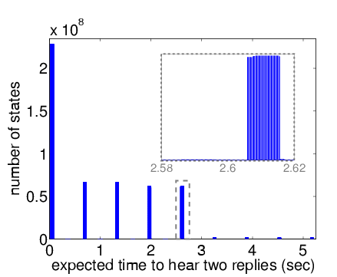
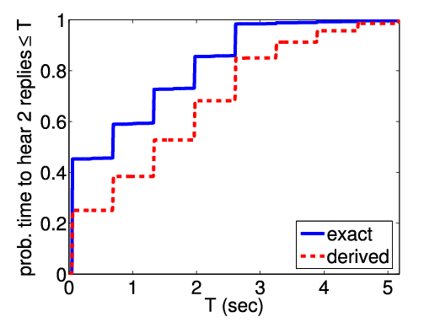
Bluetooth - Time to hear 2 replies
Worst-case expected time = 5.177s
  in 444 possible initial states
Compare actual CDF with derived version which assumes times to reply to first/second messages are independent

Slide 13
Bluetooth - Results
Other results (see [DKNP06])
  compare versions 1.2 and 1.1 of Bluetooth, confirm 1.1 slower
  power consumption analysis (using rewards)
Conclusions
  successful analysis of complex real-life model, actual parameters from standard
  exhaustive analysis: best-/worst-case values
    can pinpoint scenarios which give rise to them
    not possible with simulation approaches
  model still relatively simple
    consider multiple receivers?
    combine with simulation?

Slide 14
Contract signing
Two parties want to agree on a contract
  each will sign if the other will sign, but do not trust each other
  there may be a trusted third party (judge)
  but it should only be used if something goes wrong
In real life: contract signing with pen and paper
  sit down and write signatures simultaneously
On the Internet…
  how to exchange commitments on an asynchronous network?
  “partial secret exchange protocol” [EGL85]

Slide 15
Contract signing – EGL protocol
Partial secret exchange protocol for 2 parties (A and B)
A (B) holds 2N secrets a₁,…,a_{2N} (b₁,…,b_{2N})
  a secret is a binary string of length L
  secrets partitioned into pairs: e.g. { (a_{i}, a_{N+i}) | i=1,…,N }
  A (B) committed if B (A) knows one of A’s (B’s) pairs
Uses “1-out-of-2 oblivious transfer protocol” OT(S,R,x,y)
  S sends x and y to R
  R receives x with probability ½ otherwise receives y
  S does not know which one R receives
  if S cheats then R can detect this with probability ½

Slide 16
Contract signing – EGL protocol
(step 1)
for ( i=1,…,N )
OT( A, B, a_{i}, a_{N+i} )
OT( B, A, b_{i}, b_{N+i} )
(step 2)
for ( i=1,…,L ) (where L is the bit length of the secrets)
for ( j=1,…,2N )
A transmits bit i of secret a_{j} to B
for ( j=1,…,2N )
B transmits bit i of secret b_{j} to A

Slide 17
EGL protocol - Step 1
Party A
Party B
1…L
1…L
1…N
1…N
OT(A,B,a_{i},a_{N+i})
OT(B,A,b_{i},b_{N+i})
N+1…2N
N+1…2N
(repeat for i=1…N)

Slide 18
EGL protocol - Step 2
Party A
Party B
A sends bit i
of a_{j} to B for
j=1…2N
1…L
1…L
1…N
1…N
N+1…2N
Then B does
the same
for b_{j}
N+1…2N
(repeat for i=1…L)

Slide 19
Contract signing - Results
Modelled in PRISM as a DTMC (no concurrency) [NS06]
Discovered a weakness in the protocol
  party B can act maliciously by quitting the protocol early
  this behaviour not considered in the original analysis
PRISM analysis shows
  if B stops participating in the protocol as soon as he/she has obtained one of A pairs, then, with probability 1, at this point:
    B possesses a pair of A’s secrets
    A does not have complete knowledge of any pair of B’s secrets
  protocol is not fair under this attack:
  B has a distinct advantage over A

Slide 20
Contract signing - Results
The protocol is unfair because in step 2:
  A sends a bit for each of its secret before B does
Can we make this protocol fair by changing the message sequence scheme?
Since the protocol is asynchronous the best we can hope for is
  B (or A) has this advantage with probability ½
We consider 3 possible alternative message sequence schemes…

Slide 21
Contract signing - EGL2
(step 1)
…
(step 2)
for ( i=1,…,L )
for ( j=1,…,N ) A transmits bit i of secret a_{j} to B
for ( j=1,…,N ) B transmits bit i of secret b_{j} to A
for ( j=N+1,…,2N ) A transmits bit i of secret a_{j} to B
for ( j=N+1,…,2N ) B transmits bit i of secret b_{j} to A

Slide 22
Modified step 2 for EGL2
Party A
Party B
A sends bit i
of a_{j} to B for
j=1…N
1…L
1…L
1…N
1…N
N+1…2N
Then B does
the same
for b_{j}
N+1…2N
(after j=1…N, send j=N+1…2N)
(then repeat for i=1…L)

Slide 23
Contract signing - EGL3
(step 1)
…
(step 2)
for ( i=1,…,L ) for ( j=1,…,N )
A transmits bit i of secret a_{j} to B
B transmits bit i of secret b_{j} to A
for ( i=1,…,L ) for ( j=N+1,…,2N )
A transmits bit i of secret a_{j} to B
B transmits bit i of secret b_{j} to A

Slide 24
Modified step 2 for EGL3
Party A
Party B
A sends bit i
of a_{j} to B for
1…L
1…L
1…N
1…N
N+1…2N
Then B does
the same
for b_{j}
N+1…2N
(repeat for j=1…N and for i=1…L)
(then send j=N+1…2N for i=1…L)

Slide 25
Contract signing - EGL4
(step 1)
…
(step 2)
for ( i=1,…,L )
A transmits bit i of secret a₁ to B
for ( j=1,…,N ) B transmits bit i of secret b_{j} to A
for ( j=2,…,N ) A transmits bit i of secret a_{j} to B
for ( i=1,…,L )
A transmits bit i of secret a_{N+1} to B
for ( j=N+1,…,2N ) B transmits bit i of secret b_{j} to A
for ( j=N+2,…,2N ) A transmits bit i of secret a_{j} to B

Slide 26
Modified step 2 for EGL4
Party A
A sends bit i
of a₁ to B
Party B
1…L
1…L
Then B sends bit i of b_{j} to B
for j=1…N
1…N
1…N
Then A sends bit i of a_{j} to B
for j=2…N
N+1…2N
N+1…2N
(repeat for i=1…L)
(then send j=N+1…2N in same fashion)

Slide 27
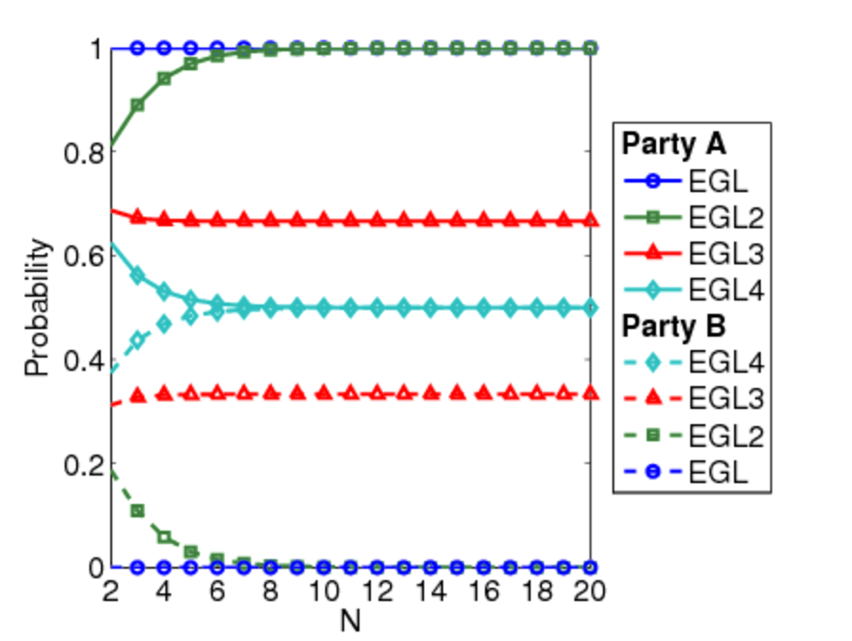
Contract signing - Results
The chance that the protocol is unfair
  probability that one party gains knowledge first
  P_{=?}[F know_{B} ∧ ¬know_{A}] and P_{=?}[F know_{A} ∧ ¬know_{B}]

Slide 28
Contract signing - Results
How unfair the protocol is to each party
  expected number of bits that a party needs to know a pair once the other party knows a pair
  need to modify the model and define a reward structure
  dependent on which party we are considering
Expected number of bits that A needs to know a pair once B knows a pair
  add a transition to a new state labelled by “done” as soon as B knows a pair
  assign a reward equal to the number of bits that A requires to know a pair to this transition
  check the formula R_{=?}[F done]

Slide 29
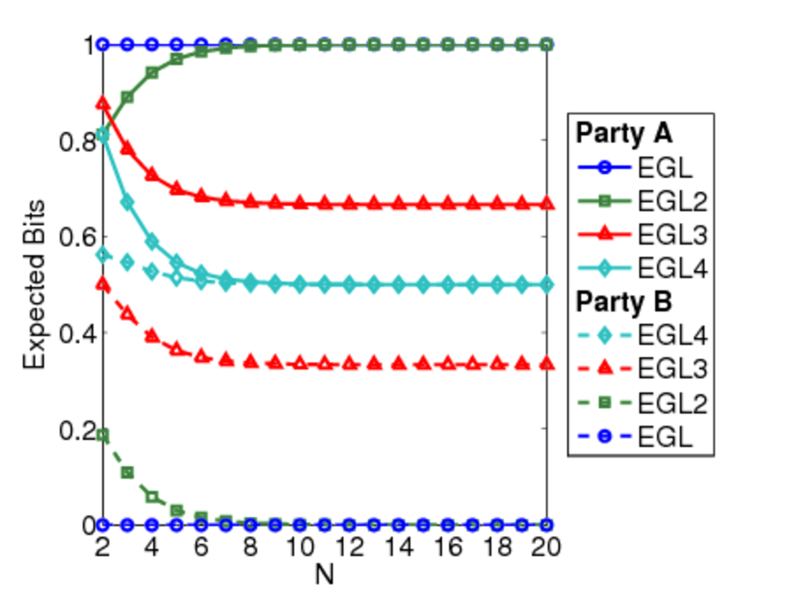
Contract signing - Results
How unfair the protocol is to each party
  expected number of bits that a party needs to know a pair once the other party knows a pair

Slide 30
Contract signing - Results
The influence that each party has on the fairness
  once a party knows a pair, the expected number of messages from this party required before the other party knows a pair
  measures the influence as a corrupted party can delay its messages
  need to define a reward structure
  dependent on which party we are considering
Once B knows a pair, the expected number of messages from B required before A knows a pair
  assign reward of 1 to transitions which correspond to B sending a message to A from a state where B knows a pair
  check the formula R_{=?}[F know_{A}]

Slide 31
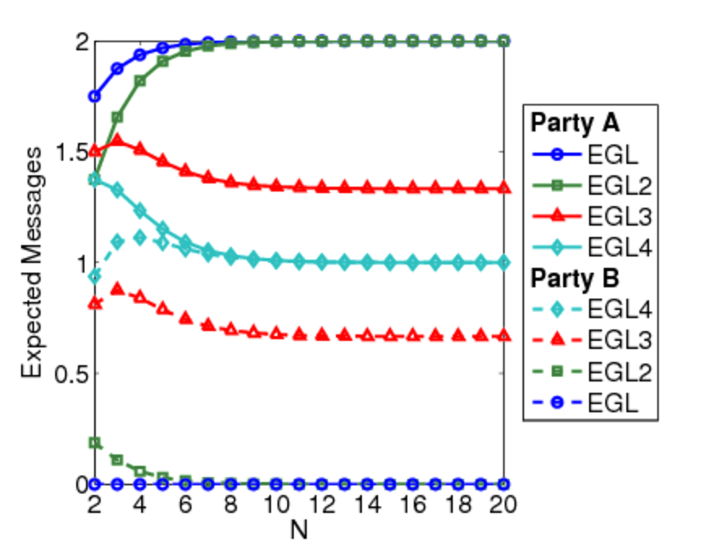
Contract signing - Results
The influence the each party has on the fairness
  once a party knows a pair, the expected number of messages from this party required before the other party knows a pair

Slide 32
Contract signing - Results
The duration of unfairness of the protocol
  once a party knows a pair, the expected total number of messages that need to be sent (by either party) before the other knows a pair
  need to define a reward structure
  dependent on which party we are considering
Once B knows a pair, the expected total number of messages that need to be sent before A knows a pair
  assign reward of 1 to transitions which correspond to either party sending a message from a state where B knows a pair
  check the formula R_{=?}[F know_{A}]

Slide 33
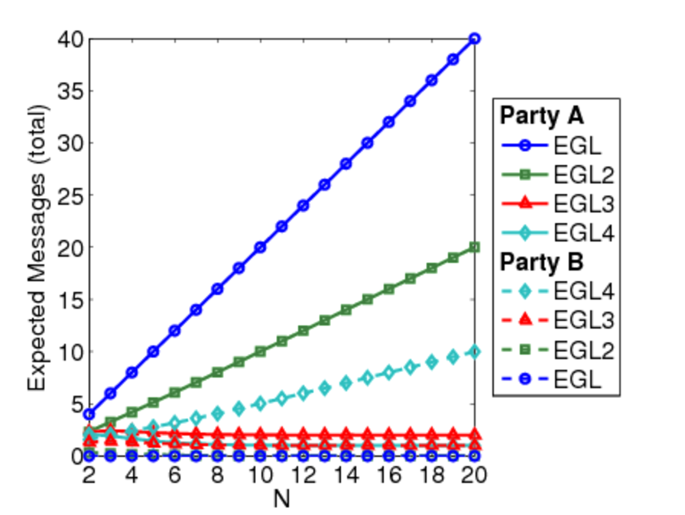
Contract signing - Results
The duration of unfairness of the protocol
  once a party knows a pair, the expected total number of messages that need to be sent before the other knows a pair

Slide 34
Contract signing - Results
Results show EGL4 is the ‘fairest’ protocol
Except for duration of fairness measure…
Expected messages that need to be sent for a party to know a pair once the other party knows a pair
  this value is larger for B than for A
  in fact, as n increases, this measure increases for B and decreases for A
Solution
  if a party sends a sequence of bits in a row (without the other party sending messages in between), require that the party send these bits as as a single message

Slide 35
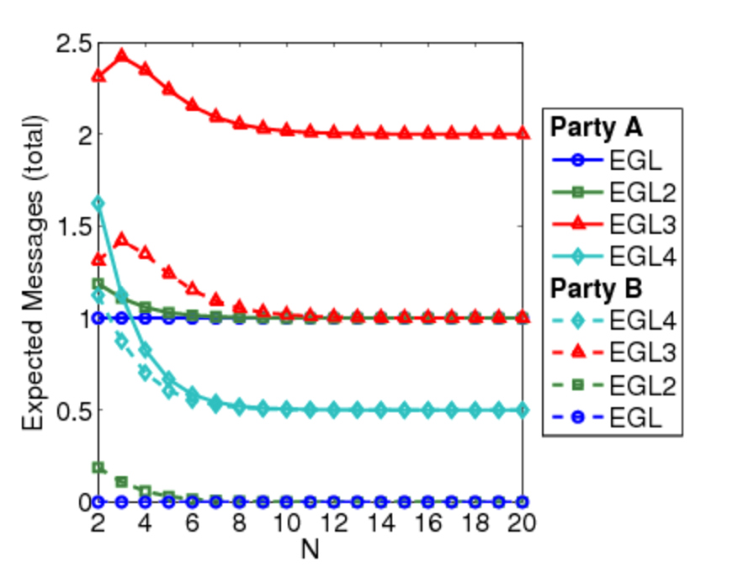
Contract signing - Results
The duration of unfairness of the protocol
  once a party knows a pair, the expected total number of messages that need to be sent before the other knows a pair

Slide 36
Summing up…
What have we achieved?
For Bluetooth device discovery,
  for the first time, obtained exact worst case expected response time to 1 message, and likewise for 2 messages
  can pinpoint the cause, impossible with simulation
  BTW, it is 2.5 seconds!
  no wonder Bluetooth gets criticised for being slow…
For contract signing
  identified an assumption missed by the authors
  proposed a fix

Slide 37
Further information
More on the Bluetooth case study
  see [DKNP06]
More on contract signing
  see [NS06]
More on similar protocols
  Crowds anonymity [Shm04]
  probabilistic anonymity [BP05]
  PIN cracking [Ste06]
More information, see the PRISM web page
  www.prismmodelchecker.org

